Slide 1
LARAVEL
The latest framework of PHP

Slide 2
What is Laravel?
a free, open-source PHP web framework.
It is a powerful MVC PHP framework.
created by Taylor Otwell (2011).
intended for the development of web applications.
designed for developers who need a simple and elegant toolkit.
create full-featured web applications.

Slide 3
Why Laravel?
Laravel is a framework - a set of general purpose components and libraries combined with programming standards that will make the development process easier and much faster.
It incorporates the basic features of PHP frameworks like Code Igniter, Yii and other programming languages like Ruby on Rails.

Slide 4
Required Software
Xampp server
php Editor
Composer
.Net Framework

Slide 5
Popularity
At the time this article was written (June 2016) Laravel was one of the most popular frameworks (based on data provided by HotFrameworks).
Laravel is 8th in general ranking and 1st on the rank of PHP based frameworks, having over 23 thousand stars on GitHub.
As a comparison, CodeIgniter is on the 2nd place with 12 thousand stars.
Now Laravel 5.2 is the stable version.

Slide 6
Advantages
Makes use of the newest features of PHP
The web application becomes more scalable, owing to the Laravel framework.
It follows a model-view-controller design pattern &
Offers a rich set of functionalities.
Laravel reuses the existing components of different frameworks which helps in creating a web application.
The web application thus designed is more structured and pragmatic.
It’s robust and easy to understand.
Considerable time is saved in designing the web application.
Laravel has a very rich set of features.
Which will boost the speed of web development.

Slide 7
The web application becomes more scalable, owing to the Laravel framework.
It follows a model-view-controller design pattern.
offers a rich set of functionalities.
Laravel reuses the existing components of different frameworks which helps in creating a web application.
The web application thus designed is more structured and pragmatic.
It’s robust and easy to understand.
Considerable time is saved in designing the web application.
Laravel has a very rich set of features.
which will boost the speed of web development.

Slide 8
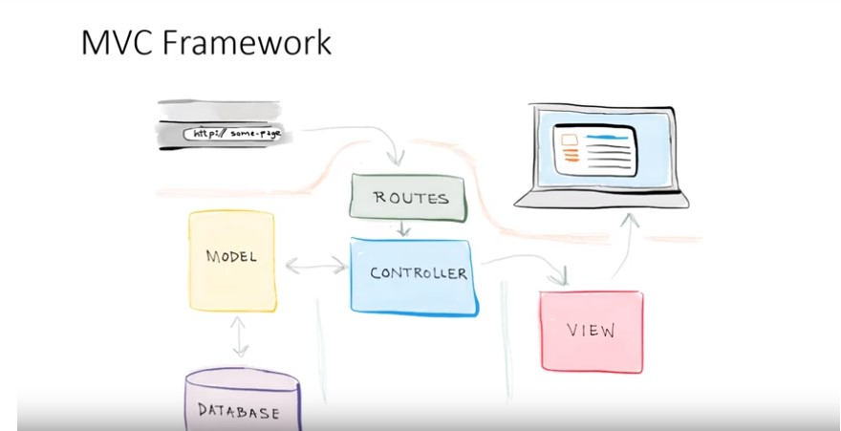
Following Models

Slide 9
Features of Laravel
Modularity
Testability
Routing
Configuration Management
Query Builder and ORM
Schema Builder
Template Engine
E-mail
Authentication
Redis
Queues
Event and Command Bus

Slide 10
Artisan
Artisan is Command line interface used in Laravel.
It includes a set of commands which assists in building a web application.
Commands are incorporated from Symphony framework.

Slide 11
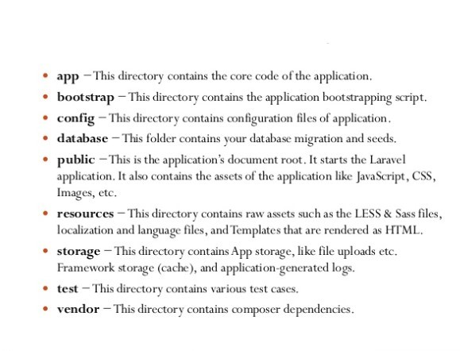
Project Structure

Slide 12
Benefits in Project:-
Laravel’s documentation is neatly structured, and different documents match various versions of Laravel.
It’s worth mentioning that sometimes it’s a good idea to look into older versions of the documentation.As I said before, Laravel is very flexible so that one can do the same thing in multiple ways.
When standard changes documentation does as well, but sometimes it’s just better to use “the old way” if it fits better your project.

Slide 13
The Demerits of Laravel
Does not support payments feature .
Lack of continuation between versions.
Some upgrades might be problematic.
Often fails to provide mobile app richness.

Slide 14
References
https:// laravel.com/docs/5.4
https://www.tutorialspoint.com

